Slide 1

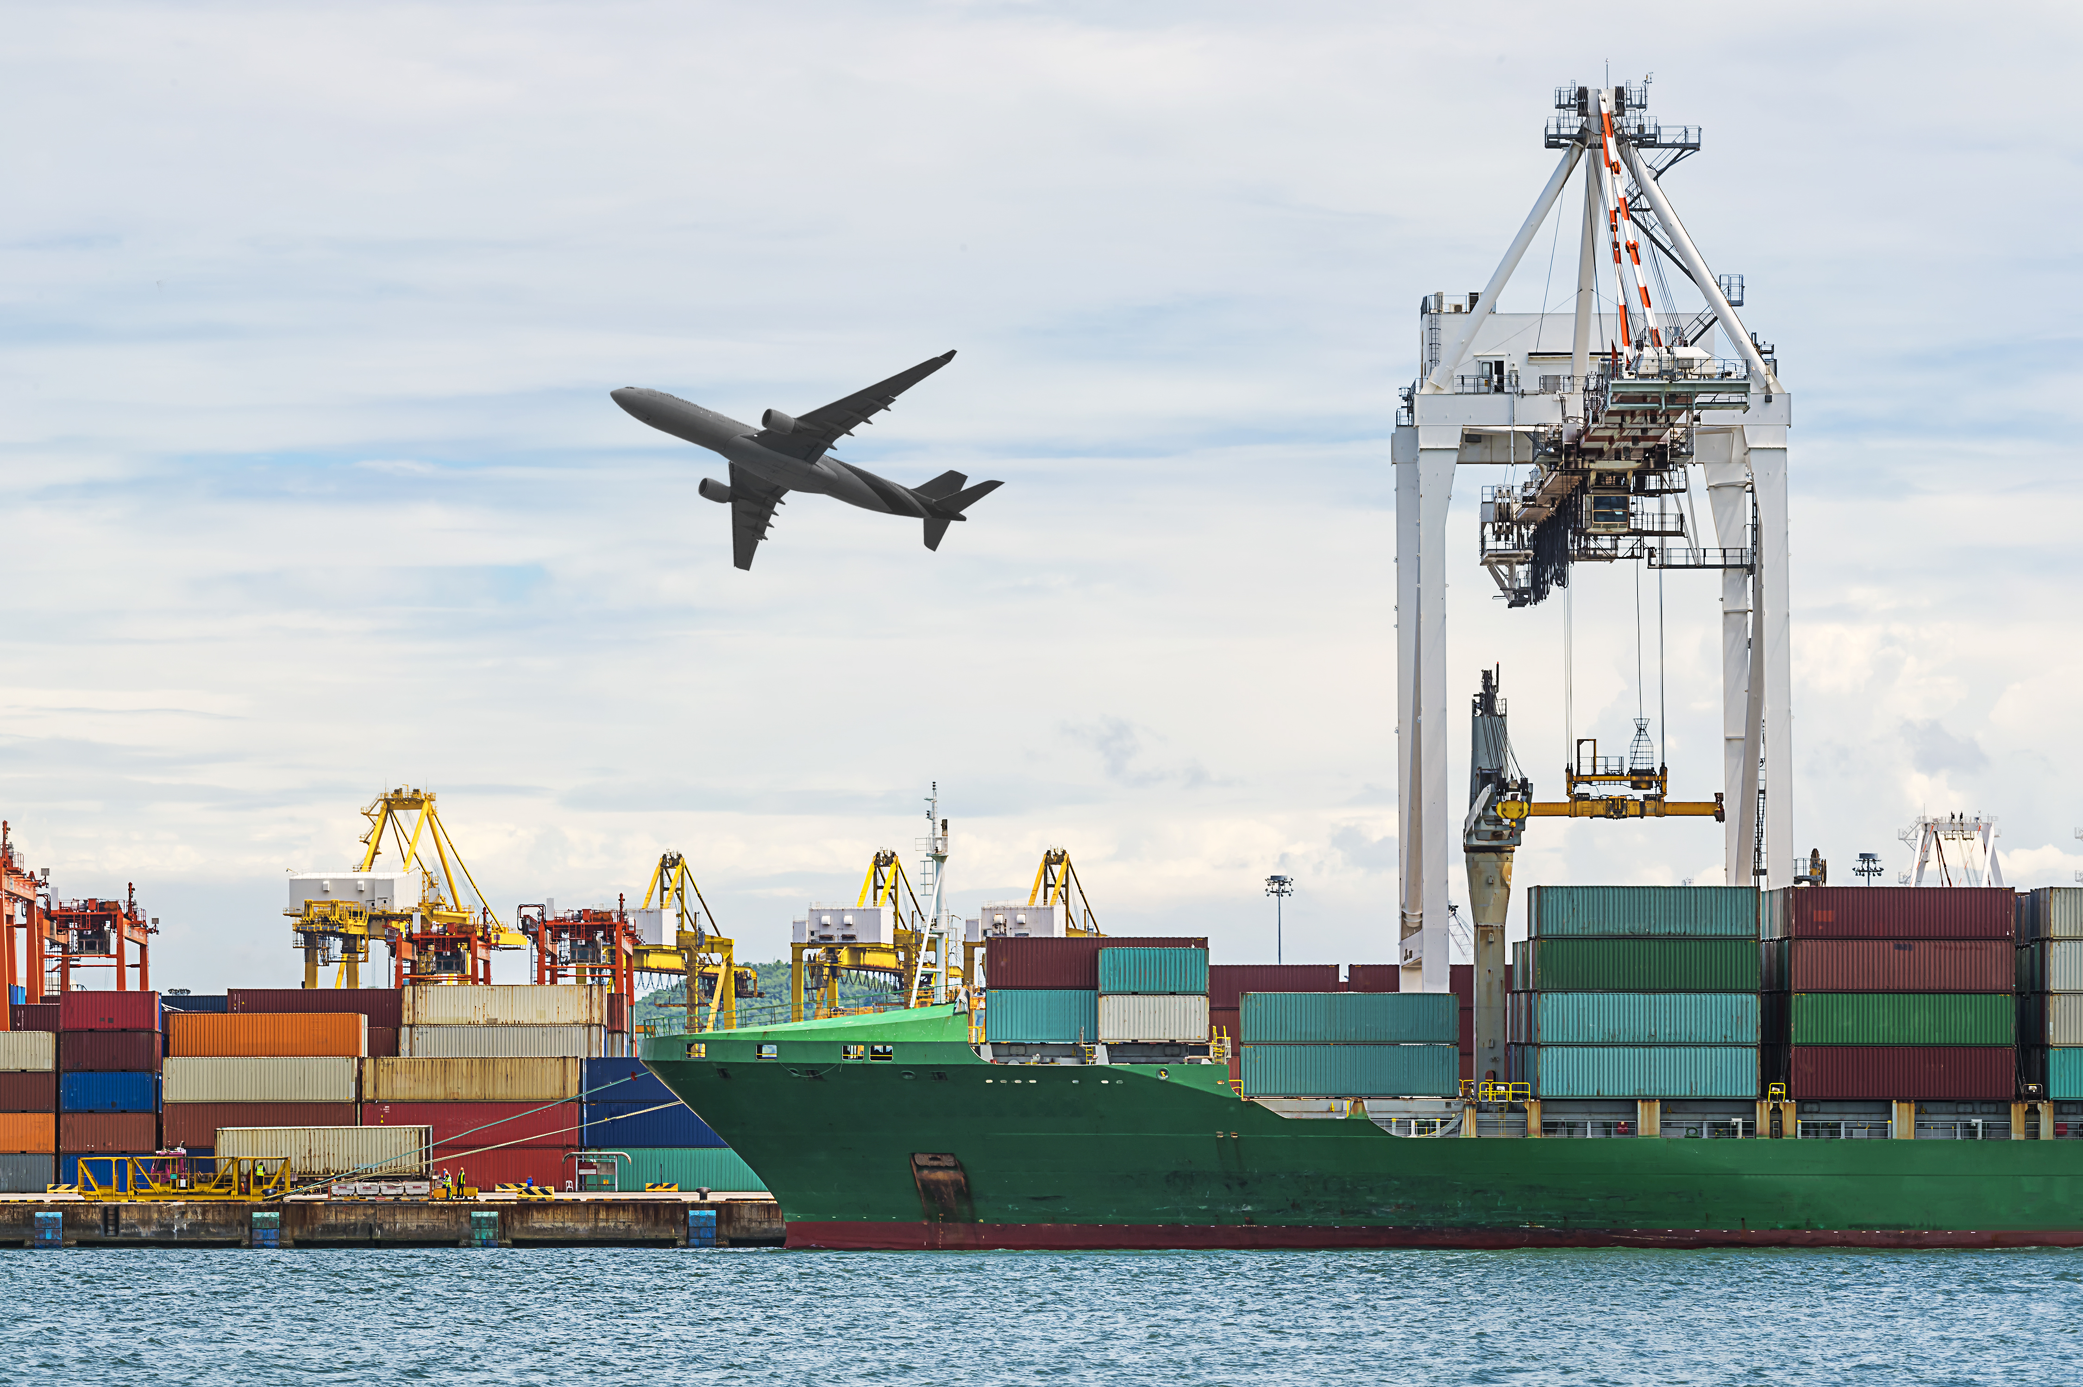
SESSION 2
Let’s Transport

Slide 2
Guiding Questions
Can you build a LEGO® robot and code a solution?
How do you change the program so the LEGO robot moves in a different way?
Outcomes
The team will build and code the LEGO® robot and then change the program.
The team will create two forms of transportation.
Could you design two forms of transportation?
Where does the cargo fit on your vehicle?
Notes:
Each session has a Guiding Questions that can be shared to frame the session.​
Session Tips
Walk the team through how to access their appropriate lesson in the app.
The team will use the LEGO Education WeDo 2.0 set and the associated apps.
You will find the estimated timing in the lesson for each page’s tasks. This is to assist with children’s self regulation.
If the team is short on time, have them do only the coding lesson and build the robot.
The team will need the assembled truck.
Give the team the LEGO prototyping pieces (Bag 4) to create their designs.
You will find that many of Max’s reflection statements connect to jobs listed on the Career Connections pages in the Engineering Notebook. This provides real life examples of transportation jobs.

Slide 3


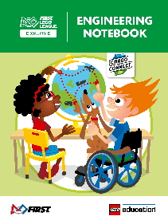
Introduction – Go Team
Examples of Teamwork
Ask the students to provide examples of Teamwork and record them here
Example of Teamwork
Example of Teamwork
We found we were stronger when we worked together.
Extension
Notes:
Introduction
Go Team
(10 minutes)
Read the definition for teamwork to the team.(see page 5)
Talk about what teamwork is. Have the team provide examples of this Core Value.
Extension: Have everyone draw a picture of an example of teamwork on the Core Values page in their Engineering Notebook.

Slide 4


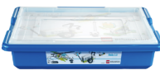
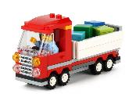
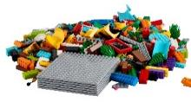
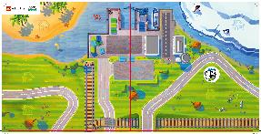
Task 1
You need…
Open the WeDo 2.0 app. Find your lesson.
Can you make the robot go in a different direction? Capture your ideas!
Explore how to change the existing program based on your ideas.
Run your new program. See what happens.
Classroom Projects:
Cooling Fan
Notes:
Tasks (20 minutes)
Open the WeDo 2.0 app. Find your lesson.
Can you make the robot go in a different direction? Capture your ideas!
Explore how to change the existing program based on your ideas.
Run your new program. See what happens.
Challenge
Can you add a propeller, steering wheel, or boat rudder to the robot?
Redesign the robot. Play your program.

Slide 5
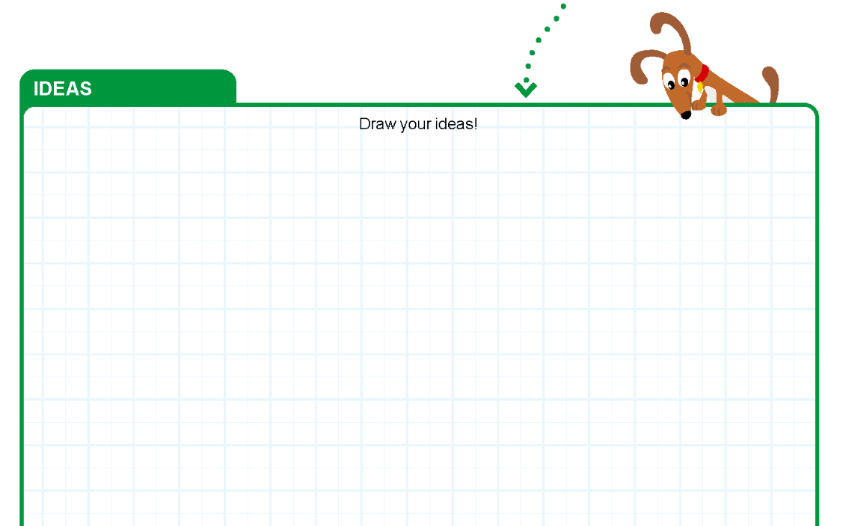
Task 1
Show me your innovative ideas!
Notes:
Tasks (20 minutes)
Open the WeDo 2.0 app. Find your lesson.
Can you make the robot go in a different direction? Capture your ideas!
Explore how to change the existing program based on your ideas.
Run your new program. See what happens.
Challenge
Can you add a propeller, steering wheel, or boat rudder to the robot?
Redesign the robot. Play your program.

Slide 6
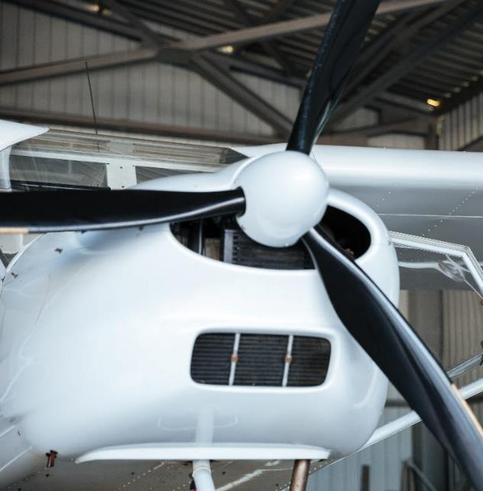
Task 1
Challenge
Can you add a propeller, steering wheel, or boat rudder to the robot?
Redesign the robot. Play your program.
Notes:
Tasks (20 minutes)
Open the WeDo 2.0 app. Find your lesson.
Can you make the robot go in a different direction? Capture your ideas!
Explore how to change the existing program based on your ideas.
Run your new program. See what happens.
Challenge
Can you add a propeller, steering wheel, or boat rudder to the robot?
Redesign the robot. Play your program.

Slide 7

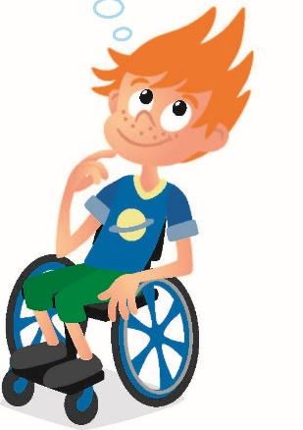
Task 2
You built a truck that transports cargo last session.
Can you create two other forms of transportation that can transport cargo?
Notes:
Tasks (20 minutes)
Explore the mat while thinking about Jacob’s question.
Draw a picture of your designs for two forms of transportation.
Share your brilliant designs with your team!
Create a design using the prototyping pieces to show your team’s solution.
Show how your creations work on the mat.

Slide 8

Task 2
Explore the mat while thinking about Jacob’s question.
Notes:
Tasks (20 minutes)
Explore the mat while thinking about Jacob’s question.
Draw a picture of your designs for two forms of transportation.
Share your brilliant designs with your team!
Create a design using the prototyping pieces to show your team’s solution.
Show how your creations work on the mat.

Slide 9
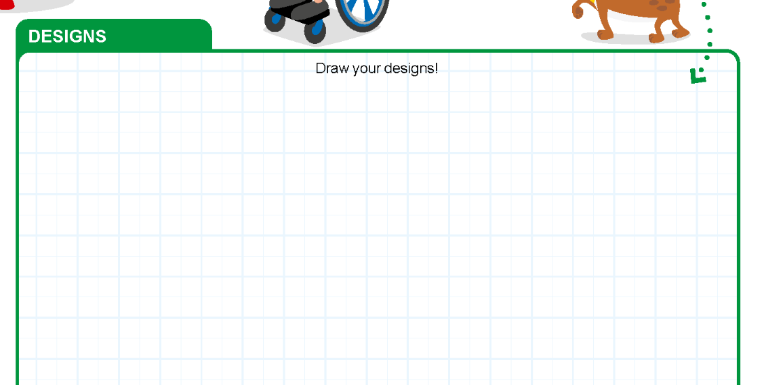
Task 2
Draw a picture of your designs for two forms of transportation.
Share your brilliant designs with your team!
Notes:
Tasks (20 minutes)
Explore the mat while thinking about Jacob’s question.
Draw a picture of your designs for two forms of transportation.
Share your brilliant designs with your team!
Create a design using the prototyping pieces to show your team’s solution.
Show how your creations work on the mat.

Slide 10
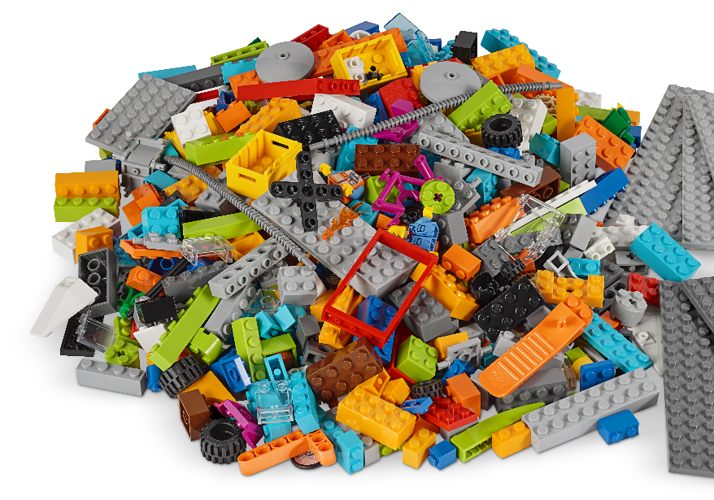
Task 2 - Explore
Create a design using the prototyping pieces to show your team’s solution.
Show how your creations work on the mat.
Notes:
Tasks (20 minutes)
Explore the mat while thinking about Jacob’s question.
Draw a picture of your designs for two forms of transportation.
Share your brilliant designs with your team!
Create a design using the prototyping pieces to show your team’s solution.
Show how your creations work on the mat.

Slide 11

Share
Share what you did in the session.
Show the coding skills you learned
Explain how you changed the program
Describe your transportation designs
Demonstrate how your solutions work on the mat.
Reflect as a team on how an engineer creates innovative designs.
Notes:
Share (10 minutes)
Have the team:
• Share what they did in the session.
• Show the coding skills they learned.
• Explain how they changed the program.
• Describe their transportation designs.
• Demonstrate how their solutions work on the mat.

Slide 12

Optional Video:
You may wish to embed a relevant, age-appropriate video for your students here. See the Notes for an example.
Notes:
Choose a relevant, age-appropriate video for your students.
Here is one example from Learning Junction: https://youtu.be/d0ySC2tzlZI
Since many videos focused on transportation for this age group will focus on transportation of people instead of cargo (including the example), you might have a short discussion about the difference between cargo transportation vehicles and vehicles intended for transporting people.

Slide 13
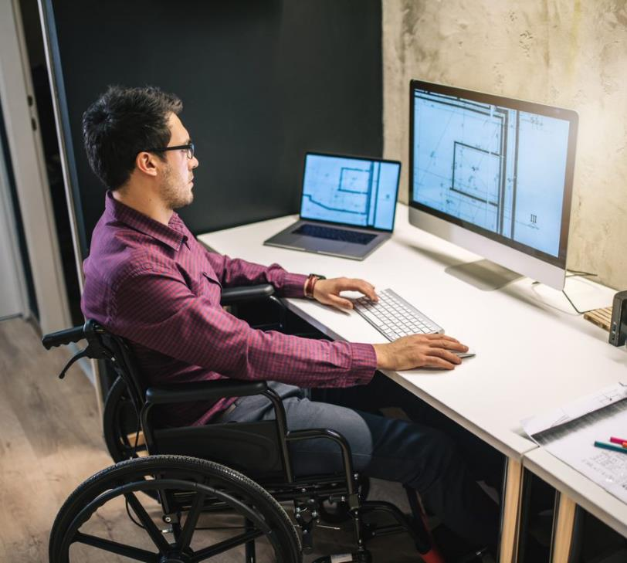
Career Connections
Cargo
Engineer
Role:
Designs ways to safely and efficiently transport cargo.
Notes:
Ask the children to reflect on what parts of the transportation journey they might like to design as a cargo engineer.

Slide 14

Clean Up
Notes:
You may wish to play a video or song during clean up time Link on GoNoodle: https://family.gonoodle.com/activities/clean-up. Link on YouTube Kids: https://www.youtubekids.com/watch?v=ZJFk87ZsHn0 . Link on Youtube: https://youtu.be/ZJFk87ZsHn0
Cleanup Pointers
• The truck should stay assembled, but everything else should be taken apart.
• Check that the pieces from the LEGO® robot are returned to the LEGO set.

Slide 15
FIRST® and the FIRST® logo are registered trademarks of For Inspiration and Recognition of Science and Technology (FIRST). LEGO® is a registered trademark of the LEGO Group. FIRST® LEGO® League and CARGO CONNECTSM are jointly held trademarks of FIRST and the LEGO Group. All other trademarks are the property of their respective owners. ©2021 FIRST and the LEGO Group. All rights reserved.

